Slide 1
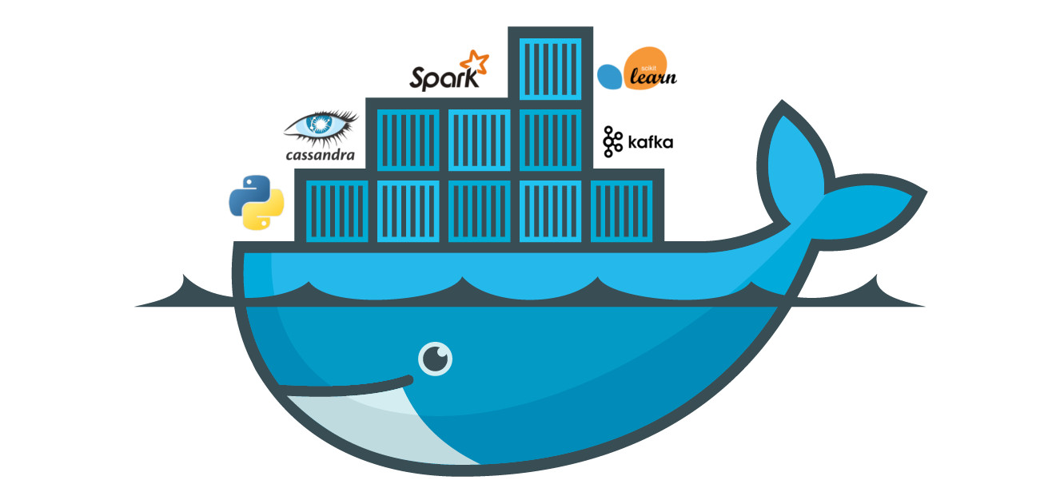
Docker

Slide 2
What is docker?
Docker is a tool that is used to automate the deployment of applications in lightweight containers so that applications can work efficiently in different environments in isolation.
The word “Docker” comes from a British colloquialism meaning
dock work__er__ — somebody who loads and unloads cargo from ships

Slide 3
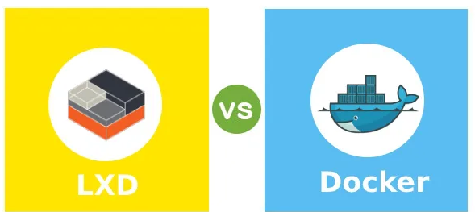
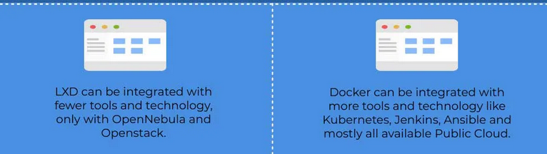
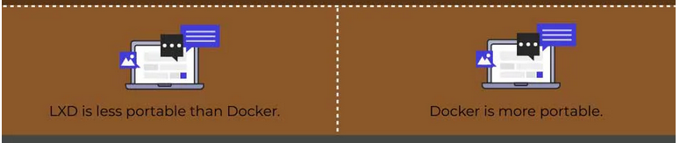
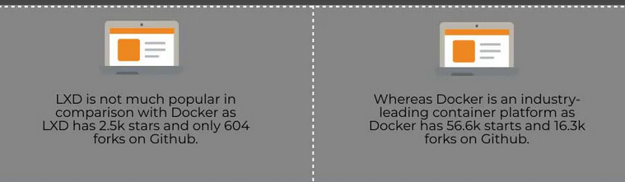
Other containerization software

Slide 4
Linux containers
Modern containers started in the Linux world, and are the product of an immense amount of work from a wide variety of people, over a long period of time. Just as one example, Google LLC has contributed many container-related technologies to the Linux kernel. Without these, and other contributions, we wouldn’t have modern containers today.
Some of the major technologies that enabled the massive growth of containers in recent years include; kernel namespaces, control groups, union filesystems, and of course Docker.

Slide 5
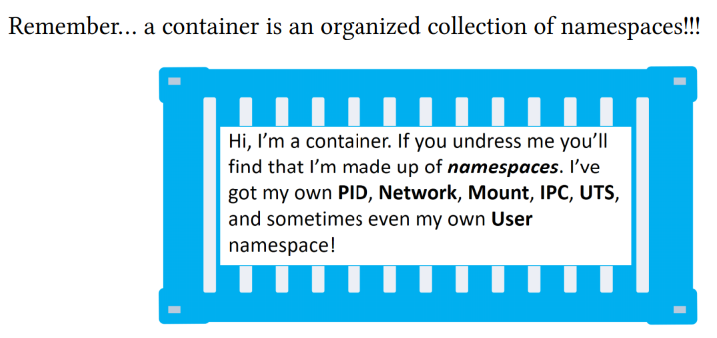
What is container ..

Slide 6
Technologies made containers possible!
Cgroups
cgroups (abbreviated from control groups) is a Linux kernel feature that limits, accounts for, and isolates the resource usage (CPU, memory, disk I/O, etc) of a collection of processes.
Engineers at Google started the work on this feature in 2006 under the name "process containers In late 2007, the nomenclature changed to "control groups" to avoid confusion caused by multiple meanings of the term "container" in the Linux kernel context, and the control groups functionality was merged into the Linux kernel mainline in kernel version 2.6.24, which was released in January 2008.[3] Since then, developers have added many new features and controllers, such as support for kernfs in 2014, firewalling,[5] and unified hierarchy.[6] cgroup v2 was merged in Linux kernel 4.5 with significant changes to the interface and internal functionality.[8]

Slide 7
cgroups
“CGroups” or “Control Groups” is a feature of the Linux kernel that allows us to control and restrict system resources (like CPU, memory, disk I/O, and network) for individual processes or groups of related processes. One of the main objectives is to manage and control the resource allocation of processes, ensuring fair and efficient usage of resources.

Slide 8
cgroups
To create new group roles add the following in the /etc/cgconfig.conf directory:
group <group_name> {
cpu {
cpu.shares="512";
}
memory {
memory.limit_in_bytes="4G";
}
}

Slide 9
Linux namespaces
Namespaces are a feature of the Linux kernel that partition kernel resources such that one set of processes sees one set of resources, while another set of processes sees a different set of resources. The feature works by having the same namespace for a set of resources and processes, but those namespaces refer to distinct resources. Resources may exist in multiple namespaces. Examples of such resources are process IDs, host-names, user IDs, file names, some names associated with network access, and Inter-process communication.
Namespaces are a fundamental aspect of containers in Linux. The term "namespace" is often used to denote a specific type of namespace (e.g. process ID) as well as for a particular space of names.
A Linux system begins with a single namespace of each type, used by all processes. Processes can create additional namespaces and can also join different namespaces.

Slide 10
Namespaces
Linux namespaces were inspired by the wider namespace functionality used heavily throughout Plan 9 from Bell Labs. The Linux Namespaces originated in 2002 in the 2.4.19 kernel with work on the mount namespace kind. Additional namespaces were added beginning in 2006 and continued into the future.
Adequate containers support functionality was finished in kernel version 3.8 with the introduction of User namespaces.

Slide 11
Namespaces
A Linux namespace is a feature that Linux kernel provides to allow us to isolate resources for a set of processes. In some way, they are a sort of implementation of the bulkhead pattern we frequently see in microservices architectures.

Slide 12
Namespaces
What are the main advantages in the use of namespaces? The main advantages are two:
Isolation of resources One troublesome process won’t be taking down the whole host, it’ll only affect those processes belonging to a particular namespace.
Security The other advantage is that a security flaw in the process or processes running under a given namespace, won’t give access to the attacker to the whole system. Whatever he/she could do, will always be contained within the boundaries of that namespace! This is why it’s also very important to avoid running our processes using privileged users whenever possible.

Slide 13
Namespace types
User Namespace
Process ID Namespace
Network Namespace
Mount Namespace
IPC Namespace
UTS Namespace

Slide 14
Namespaces
To create a new UTS namespace and change the hostname to bar run the following script:
sudo unshare --uts /bin/bash
hostname bar
hostname
exit
To lists all current namespaces run the following script:
lsns
lsns -l ls -lai /proc/1/ns

Slide 15
Linux Capabilities
Namespaces are one of the building blocks of isolation used by the docker-formatted containers. They provide such an environment for a process, that prevents the process from seeing or interacting with other processes. For example, a process inside a container can have PID 1, and the same process can have a normal PID outside of a container. The process ID (PID) namespace is the mechanism which remaps PIDs inside a container.
However, containers can still access some resources from the host such as the kernel and kernel modules, the /proc file system and the system time. The Linux Capabilities can limit access by containerized processes to the system features.

Slide 16
Linux Capabilities
The Linux capabilities feature breaks up the privileges available to processes run as the root user into smaller groups of privileges. This way a process running with root privilege can be limited to get only the minimal permissions it needs to perform its operation. Docker supports the Linux capabilities as part of the docker run command: with --cap-add and --cap-drop. By default, a container is started with several capabilities that are allowed by default and can be dropped. Other permissions can be added manually. Both --cap-add and --cap-drop support the ALL value, to allow or drop all capabilities.

Slide 17
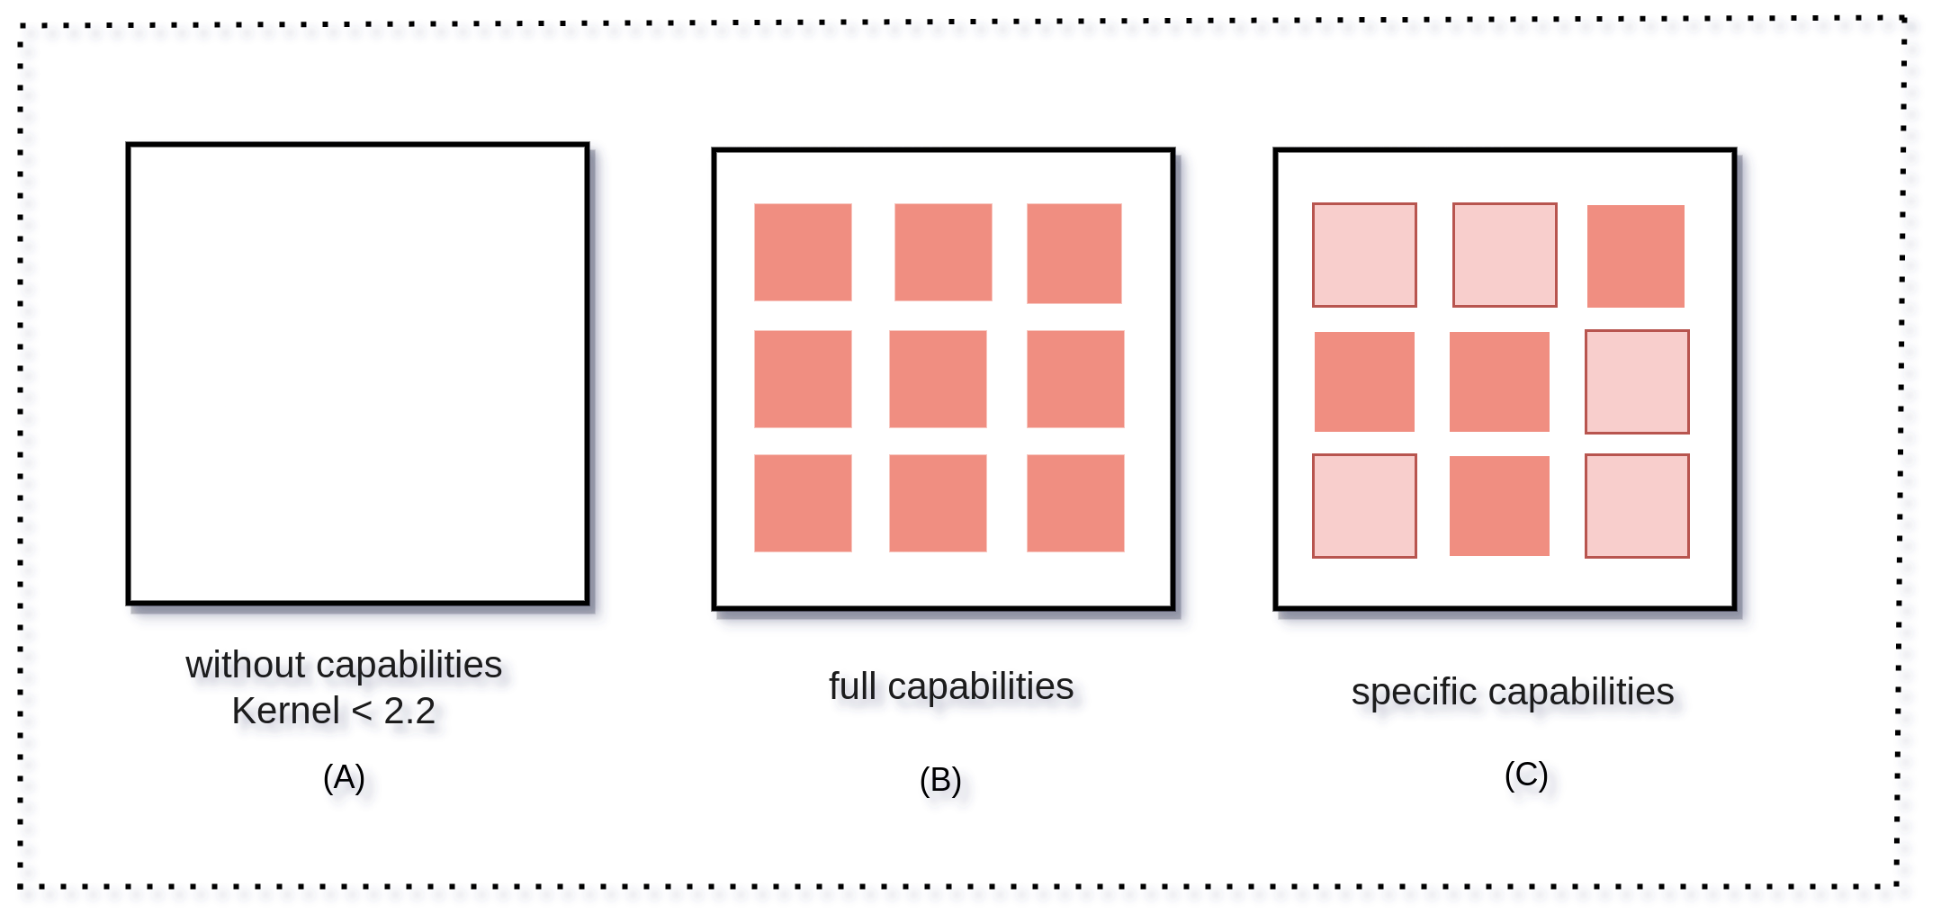
Linux Capabilities

Slide 18
Linux Capabilities
setcap cap_net_bind_service+ep /path/to/the/binary getcap /path/to/the/binary
setcap -r /path/to/the/binary
setcap "all+pe cap_chown-pe" /path/to/binary
setcap =pe /path/to/binary

Slide 19

Capabilities in the Context of Containers
When you start a container by default, it starts with some capabilities given by the container runtime. Tools like Docker give you the flexibility to add and drop capabilities depending on the requirements. To work with this, you need to know what capabilities required by your container will not work according to expectation.
docker run --privileged -d nginx

Slide 20
Hello Containers!
For a long time, the big web-scale players, like Google, have been using container technologies to address the shortcomings of the VM model.
In the container model, the container is roughly analogous to the VM. The major difference is that every container does not require its own full-blown OS. In fact, all containers on a single host share a single OS. This frees up huge amounts of system resources such as CPU, RAM, and storage. It also reduces potential licensing costs and reduces the overhead of OS patching and other maintenance. Net result: savings on the cap-ex and op-ex fronts.

Slide 21
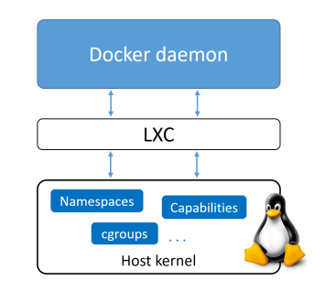
Docker daemon
The Docker daemon was a monolithic binary. It contained all of the code for the Docker client, the Docker API, the container runtime, image builds, and much more.
LXC provided the daemon with access to the fundamental building-blocks of containers that existed in the Linux kernel. Things like namespaces and control groups (cgroups).

Slide 22
Getting rid of LXC
The reliance on LXC was an issue from the start.
First up, LXC is Linux-specific. This was a problem for a project that had aspirations of being multi-platform.
Second up, being reliant on an external tool for something so core to the project was a huge risk that could hinder development.
As a result, Docker. Inc. developed their own tool called libcontainer as a replacement for LXC. The goal of libcontainer was to be a platform-agnostic tool that provided

Slide 23
Getting rid of the monolithic Docker daemon
Over time, the monolithic nature of the Docker daemon became more and more problematic:
1. It’s hard to innovate on.
2. It got slower.
3. It wasn’t what the ecosystem (or Docker, Inc.) wanted.
Docker, Inc. was aware of these challenges, and began a huge effort to break apart the monolithic daemon and modularize it. The aim of this work was to break out as much of the functionality as possible from the daemon, and re-implement it in smaller specialized tools. These specialized tools can be swapped out, as well as easily re-used by third parties to build other tools. This plan follows the tried-and-tested Unix philosophy of building small specialized tools that can be pieced together into larger tools.

Slide 24
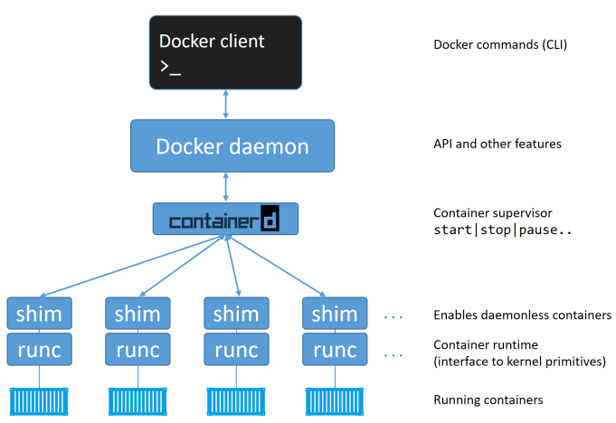

Slide 25

The Open Container Initiative (OCI)
Open Container Initiative
The Open Container Initiative is an open governance structure for the express purpose of creating open industry standards around container formats and runtimes.
Established in June 2015 by Docker and other leaders in the container industry, the OCI currently contains three specifications: the Runtime Specification (runtime-spec), the Image Specification (image-spec) and the Distribution Specification (distribution-spec). The Runtime Specification outlines how to run a “filesystem bundle” that is unpacked on disk. At a high-level an OCI implementation would download an OCI Image then unpack that image into an OCI Runtime filesystem bundle. At this point the OCI Runtime Bundle would be run by an OCI Runtime.

Slide 26
OCI
The OCI has published two specifications (standards):
The image-spec
The runtime-spec

Slide 27
